Slide 1

DREAM
TEAM
Deep Learning Image Classification with CNN
Guy
Mehak
Ambrose
Jurgen

Slide 2
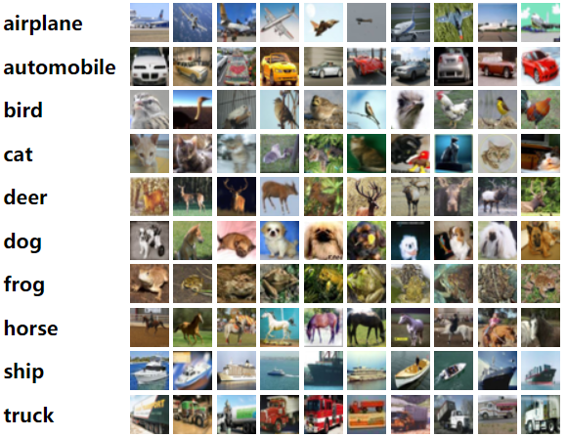
WHY CIFAR-10?
Diversity: Covers a broad range of classes for practical applications.
Size: Small size makes it computationally efficient for training and testing.
Benchmark: Widely used dataset for evaluating CNN and Transfer Learning models.

Slide 3
Overview of the problem
Design and implement two Convolutional Neural Networks (CNNs) to classify images into 10 distinct classes:
Build a CNN from scratch to perform the classification.
Apply transfer learning to leverage a pre-trained model for improved performance on the same task.
Challenges:
Small image resolution adds complexity to feature extraction.
Preventing overfitting requires careful architecture design.
Efficiently utilizing computational resources for training.

Slide 4
Data preprocessing - 1
Image normalization:
Improve Numerical Stability: ensures inputs have a consistent scale
Faster Convergence: allows the optimization algorithms
Prevent Dominance of Large-Scale Features: ensures that all features contribute equally to the training process.
Generalization to Test Data: :helps the model generalize better when encountering unseen test data.
Code:
mean = train_images.mean(axis=(0,1,2), keepdims=True)
std = train_images.std(axis=(0,1,2), keepdims=True)
train_images = (train_images - mean) / std
test_images = (test_images - mean) / std

Slide 5
Data preprocessing - 2
Data augmentation:
Generalization: Improve model generalization by creating variability in the training data.
Simulate Real-World Variations: helps the model learn invariance to these variations by introducing them artificially during training
Avoid Overfitting: prevents the model from memorizing specific features and forces it to learn more general, robust patterns.
Code:
datagen = ImageDataGenerator(
rotation_range=15,
horizontal_flip=True,
width_shift_range=0.1,
height_shift_range=0.1
)
datagen.fit(train_images)

Slide 6
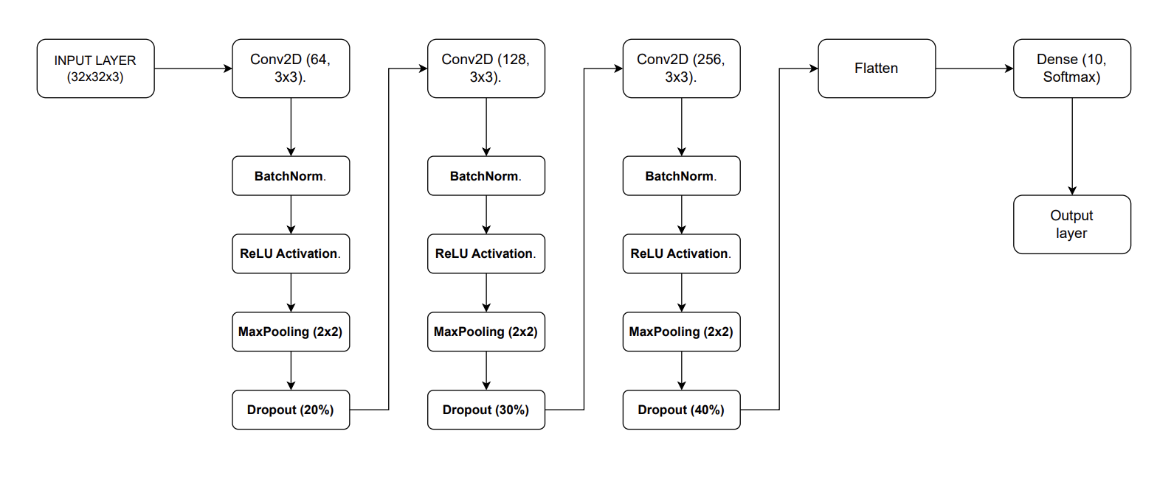
Dream Team CNN Optimization
Using Multiple convolutional blocks with increasing nodes allows efficient hierarchical feature extraction

Slide 7
Dream Team CNN Optimization
Learning rate scheduler enables more precise learning after capturing main structures
def lr_scheduler(epoch):
if epoch < 30:
return 0.001
else:
return 0.0001
lr_callback = LearningRateScheduler(lr_scheduler)
AdamW as optimizer offers all the features of Adam but has the added benefit of weight decay implementation

Slide 8

Dream Team CNN Optimization
Small weight decay (1e-6) alongside L2 to improve stability and
generalization
model = models.Sequential()
weight_decay = 1e-6
# Convolutional Block 1
model.add(layers.Conv2D(64, (3,3),padding='same',kernel_regularizer=regularizers.l2(weight_decay),
input_shape=(32,32,3)))
model.add(BatchNormalization())
model.add(layers.Activation('relu'))
model.add(layers.Conv2D(64, (3,3), padding='same',kernel_regularizer=regularizers.l2(weight_decay))
model.add(BatchNormalization())
model.add(layers.Activation('relu'))
model.add(layers.MaxPooling2D(pool_size=(2,2)))

Slide 9
Transfer Learning with ResNet18 (ResNet50V2 used)
Base Model: ResNet18 (pretrained on ImageNet).
Why ResNet18
Residual Connections: Avoid vanishing gradient problems in deep networks.
Lightweight: Smaller model compared to ResNet50, ideal for CIFAR-10's resolution.
Pretrained Knowledge: Learns low-level features (like edges and textures) effectively, reducing training time.
Modifications:
Removed the top dense layers.
Added custom dense layers (256 units with dropout(0.5).
Final layer modified for 10-class output using so.

Slide 10
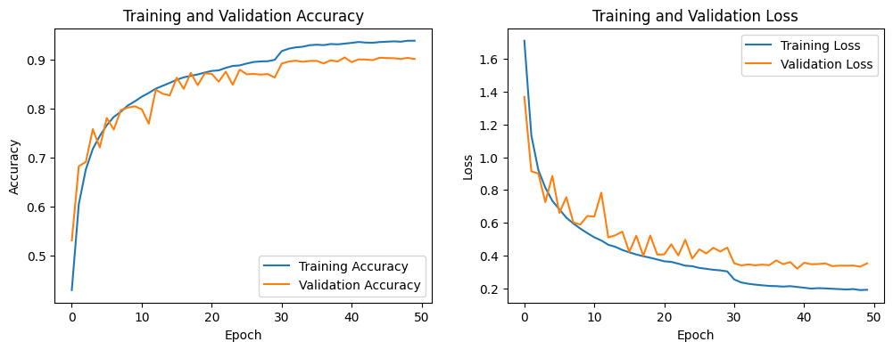
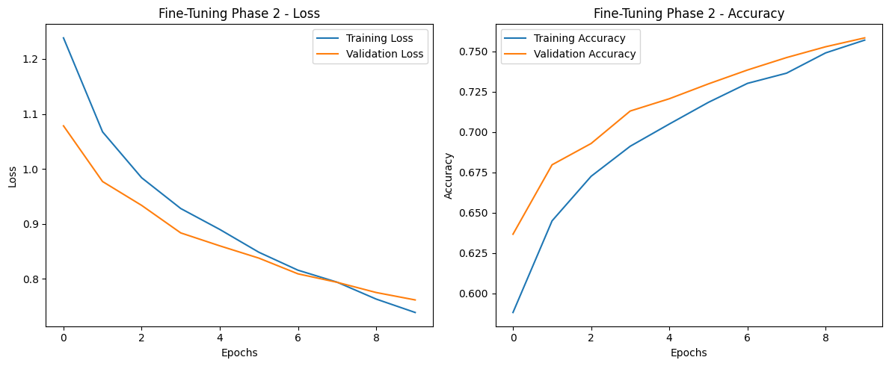
Evaluation Metrics
Dream Team CNN:
Accuracy = 90.41%
Loss = 0.3191
Transfer Learning:
Accuracy = 76.0%
Loss = 0.7575
Custom CNN
Transfer Learning

Slide 11
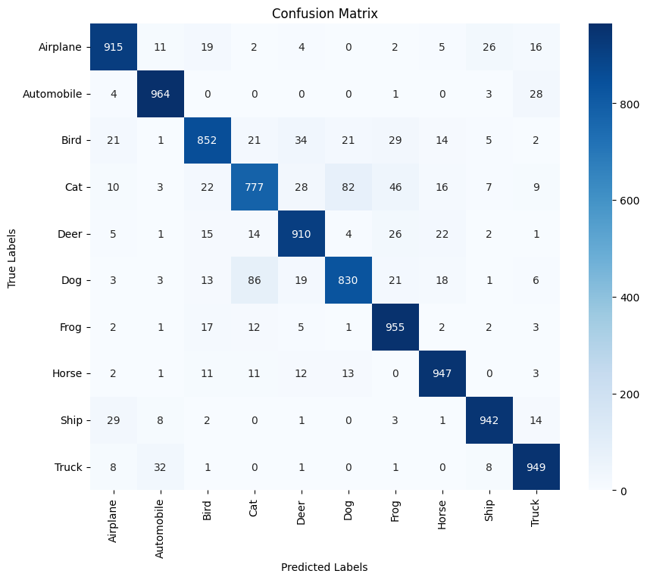
Evaluation - Confusion Matrix (Dream Team CNN)
Confusion Matrix Visualization:
•High accuracy for categories like Ship, Truck, and Airplane.
•Moderate confusion in visually similar classes like Cat and Dog.
Takeaways:
•Strong performance with augmented data and transfer learning.
•Class imbalances in CIFAR-10 may affect per-class accuracy.

Slide 12
Model deployment with Gradio
Hosted on Hugging Face
Step:
Load the pre-trained Custom CNN model.
Define a function to resizes (to 32 pixel), normalizes and predict the class of the input image.
3. Initializing the Gradio interface.
4. Host both the model and the code on Hugging Face Spaces; then configuring the
environment for public accessibility and testing.
Link : https://huggingface.co/spaces/sudoambrose/CNN_App

Slide 13
Final Recap
Dataset: CIFAR-10 Methods:
Dream Team CNN: Focused on optimizing architecture for CIFAR-10.
ResNet18: Leveraged pretrained knowledge for enhanced feature extraction.
Optimization:Regularization, Dropout, and Learning Rate Schedules ensured stable training.
Results:Dream Team CNN: 90% accuracy. ResNet18 Fine-Tuned: 76% accuracy.
Future Work:Explore deployment strategies.Extend training to larger pretrained models for improved performance.

